Slide 1
Section 2: Processes, Interrupts, GNU C Library Functions
William

Slide 2
PROCESSES
Definitions
PROCESS CONCEPT:
A program is passive; a process active.
Attributes held by a process include
hardware state,
memory,
CPU,
progress (executing)
WHY HAVE PROCESSES?
Resource sharing ( logical (files) and physical(hardware) ).
Computation speedup - taking advantage of multiprogramming – i.e. example of a customer/server database system.
Modularity for protection.

Slide 3
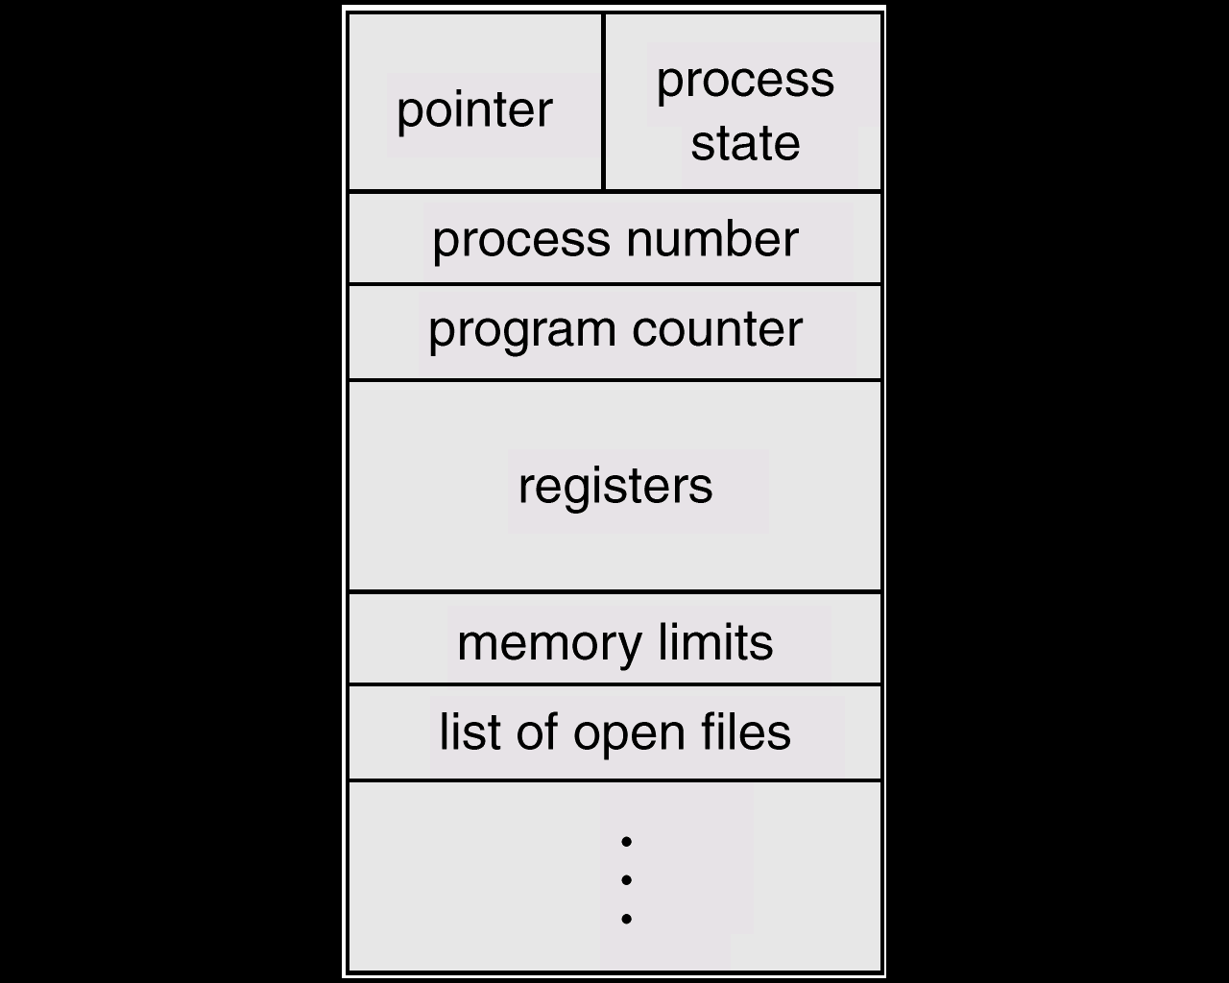
PROCESSES
Process State
PROCESS CONTROL BLOCK:
CONTAINS INFORMATION ASSOCIATED WITH EACH PROCESS:
It's a data structure holding:
PC, CPU registers,
memory management information,
accounting ( time used, ID, ... )
I/O status ( such as file resources ),
scheduling data ( relative priority, etc. )
Process State (so running, suspended, etc. is simply a field in the PCB ).

Slide 4
Why Processes?
Consider Web Server
Needs to get network message (URL) from client, fetch URL data from disk, compose response, send response
How many incoming requests can this serve?
Access data all over disk?
Bad performance….

Slide 5
New Web Server
Gets network message(URL) from client
Creates child process: child process responsible for fetching URL data from disk, compose response, send response
Parallelizing requests, able to serve more

Slide 6
Processes useful also for web browser
Fork a new process for each request
Protects against one instance of malicious JavaScript code taking over entire browser
Process is basic unit of protected execution.
Also, multitasking!

Slide 7
Interrupts
Interrupts are signals sent to the CPU by external devices, normally I/O devices. They tell the CPU to stop its current activities and execute the appropriate part of the operating system
Can be implemented in hardware/software, different depending on OS

Slide 8
CPU’s ‘fetch-execute’ cycle
User
Program
Fetch instruction at IP
ld
add
st
mul
ld
sub
bne
add
jmp
…
Decode the fetched instruction
Save context
IP
Get INTR ID
Execute the decoded instruction
Lookup ISR
Advance IP to next instruction
Execute ISR
Interrupt?
yes
IRET
no

Slide 9
Hardware or Software
Memory Bus
IRQs
0
PIC
idtr
CPU
INTR
IDT
0
vector
N
handler
Mask points
255

Slide 10
Similar Steps for all Interrupts
Using the pointer to the current process control block, the state and all register values for the process are saved onto kernel stack for use when the process is later restarted.
The CPU mode bit is switched to supervisory mode -> (kernel mode).
Using the pointer to the interrupt handler table and the interrupt vector, the location of the kernel code to execute is determined. The interrupt vector is the IRQ for hardware interrupts (read from an interrupt controller register) and an argument to the interrupt assembly language instruction for software interrupts.
Processing is switched to the appropriate portion of the kernel.

Slide 11
Where to save state?
Kernel threads
x86_64 has a kernel stack for every active thread
While the thread is in user space the kernel stack is empty except for the thread_info structure at the bottom.
specialized stakcs associated with CPU: interrupt stack
Save reigsters/state to kernel stack. Jump to interrupt handler. Interrupt handler state saved onto interrupt stack.
After interrupt handler completes, resumes interrupted process. Gets return address of user process PC, jumps there.

Slide 12
Part 2: System Calls in C
System Call Interface
On Unix-like systems, SCI API is usually part of an implementation of the C library (libc), such as glibc, that provides wrapper functions for the system calls, often named the same as the system calls that they call.
Process Management with C
fork()
exec()
wait()
exit()
Signal()
Pipe()
Dup()
Dup2()

Slide 13
System Call Interface
App Software
User-running
API
syscall - trap
Sys Software
“You are here”
Kernel-running
exit()
Zombie
Sys Call (OS) Interface
read(), write(),
wait(), sleep()
OS
Blocked
Ready
Sw-Hw I-face (drivers)
Hardware

Slide 14
The fork() System Call (1)
A process calling fork() spawns a child process.
assigns a new process entry in the process table and clones the information from the current one
All file descriptors that are open in the parent will be open in the the child. The executable memory image is copied as well.
The only difference is that the child gets a different return value from fork.
The parent gets the procsss ID of the child that was just created. The child gets a return of 0. If fork returns -1 then the operating system was unable to create the process.

Slide 15
DEMO – FORK1.C
The parent prints a message stating its process ID and the child's process ID.
The parent and child then each exit.
Parameter is exit code of the program. The convention for Unix systems is to exit with a code of zero on success and a non-zero on failure.

Slide 16
System() – SYSTEM-EX.C
The C library function int system(const char *command) passes the command name or program name specified by command to the host environment to be executed by the command processor and returns after the command has been completed.

Slide 17
The exec()System Call (1)
The exec() call replaces a current process‘ execution image with a new one (i.e. loads a new program within current process).
new process is not created, the process identifier (PID) does not change, but the machine code, data, heap, and stack of the process are replaced by those of the new program.
In OS command interpreters, exec built-in command replaces the shell process with the specified program.
Try typing in exec ls in your terminal!
The new image is either regular executable binary file or a shell script.

Slide 18
There’s no a syscall under the name exec(). By exec() we usually refer to a family of calls:
int execl(char *path, char *arg, ...);
int execv(char *path, char *argv[]);
int execle(char *path, char *arg, ..., char *envp[]);
int execve(char *path, char *argv[], char *envp[]);
int execlp(char *file, char *arg, ...);
int execvp(char *file, char *argv[]);
Here's what l, v, e, and p mean:
l means an argument list,
v means an argument vector,
e means an environment vector, and
p means a search path.

Slide 19
The exec()System Call (2)
Upon success, exec() never returns to the caller. If it does return, it means the call failed. Typical reasons are: non-existent file (bad path) or bad permissions.
Arguments passed via exec() appear in the argv[] of the main() function.
PID=28
PID=28
exec()
p1
p1
Legend:
Old Program
New Program

Slide 20
Environment
The e-exec calls use the environment when attempt to invoke a new program.
Name = Value
HOME
PATH
SHELL
USER
LOGNAME
...
set or env - will display current environment, which you can modify with:
the export command in a shell or a shell script (bash);
the setenv for tcsh
the getenv(), setenv(), putenv(), etc. in C

Slide 21
fork() and exec() Combined
Often after doing fork() we want to load a new program into the child. E.g.: a shell.
tcsh
tcsh
tcsh
PID=28
PID=28
fork()
PID=34
p1
p1
c1
tcsh
ls
PID=34
PID=34
exec(ls)
c1
c1

Slide 22
The System wait() Call
Forces the parent to suspend execution, i.e. wait for its children or a specific child to die (terminate is more appropriate terminology, but a bit less common).

Slide 23
The System wait() Call (2)
#include <sys/types.h>
#include <sys/wait.h>
pid_t wait(int *status);
pid_t waitpid(pid_t pid, int *status, int options);
The wait() causes the parent to wait for any child process.
The waitpid() waits for the child with specific PID.
The status, if not NULL, stores exit information of the child, which can be analyzed by the parent using the W*() macros.
http://man7.org/linux/man-pages/man2/wait.2.html
The return value is:
PID of the exited process, if no error
(-1) if an error has happened

Slide 24
HW1 Hints
How to wait for all background processes to finish?
Fork child process. The stack will be copied completely. Copied, not shared. Thus if you want your parent and child to communicate you have to use sockets or shared memory.
Better approach: http://man7.org/linux/man-pages/man3/errno.3.html

Slide 25
Errno.h
The <errno.h> header file defines the integer variable errno, which is set by system calls and some library functions in the event of an error to indicate what went wrong.
ECHILD No child processes (POSIX.1)
while (pid = wait(NULL))) {
if (errno == ECHILD) {
break;
}
}

Slide 26
Zombie Processes
When a child process terminates, it continues to exist as an entry in the system process table even though it is no longer an actively executing program.
Typically waited on by its parent, and reclaimed by system
If a child is not waited on by its parent, it continues to consume this resource indefinitely, and thus is a resource leak -> Zombie Processes
Look out for when doing hw1!

Slide 27
How to get rid of zombie processes?
Signals
SIGCHLD is a signal your program receives if a child process gets terminated.
void cleanup_child(int signal) {
wait();
}
signal(SIGCHLD,cleanup_child);

Slide 28
The exit() System Call
#include <stdlib.h>
void exit(int status);
This call gracefully terminates process execution. Gracefully means it does clean up and release of resources, and puts the process into the zombie state.
exit() specifies a return value from the program, which a parent process might want to examine as well as status of the dead process.
_exit() call is another possibility of quick death without cleanup.

Slide 29
Ex4.c

Slide 30
UNIX signals & pipes

Slide 31
UNIX Signals
A UNIX signal corresponds to an event
It is raised by one process (or hardware) to call another process’s attention to an event
It can be caught (or ignored) by the subject process
Justification for including signals was for the OS to inform a user process of an event
User pressed delete key
Program tried to divide by zero
Attempt to write to a nonexistent pipe
etc.

Slide 32
More on Signals
UNIX has a fixed set of signals (Linux has 32 of them)
signal.h defines the signals in the OS
Raise a signal with kill(pid, signal)
3 ways to handle a signal
Ignore it: signal(SIG#, SIG_IGN)
Run the default handler: signal(SIG#, SIG_DFL)
Run the user handler: signal(SIG#, myHandler)

Slide 33
Signal Handling
/* code for process p */
. . .
signal(SIG#, sig_hndlr);
. . .
/* ARBITRARY CODE */
void sig_hndlr(...){
…
/* handler code */
}
An executing process, q
q raises “SIG#” for “p”
q is blocked
sig_hndlr runs in
p’s address space
q resumes execution

Slide 34
SIGNAL EXAMPLES
Signal4.c //another way to implement waiting for all background processes in hw1
Signals-ex.c //can SIGKILL be handled by our own function?

Slide 35
UNIX Pipes
The pipe interface is intended to look like a file interface
Analog of open is to create the pipe: pipe(p)
Kernel creates a buffer with two pointers p[0] and p[1]
File read / write calls are used to send/receive information on the pipe
Processes use p[1] to write and p[0] to read
pipe handles (p[0] & p[1]) are copied on fork() (similar to file handles)
int p[2];
. . .
pipe(p);
. . .
if(fork() == 0) { /* the child */
. . .
read(p[0], childBuf, len);
. . .
} else { /* the parent */
. . .
write(p[1], msgToChild, len);
. . .
}

Slide 36
UNIX Pipes
Parent process, P
Child process, Q
int p[2];
pipe(p);
…
fork()
…
write(p[1], “hello”, size);
…
/* gets a copy of parent’s local variables including the pipe pointers p[0] and p[1] */
…
read(p[0], inbuf, size);
…
pipe for P and Q
write function
Φolleh
read function
FIFO buffer
size = 4096 characters

Slide 37
UNIX Pipes (cont)
The normal write is an asynchronous operation (that notifies of write errors)
(i.e. write and the corresponding read do not happen at the same time.)
The normal read is a blocking read; there is also a nonblocking read.
dup2(int Pptr, int ptr2) system call causes the file descriptor ptr2 to refer to the same file as Pptr.
e.g. dup2(p[1], 1)
causes stdout to refer to the write end of the pipe

Slide 38
Examples
Pipe-ex.c
Fork_ex5.c //integration example of everything

